Slide 1
GIT & Github
Name : Md . Zahid Islam Shuvo
Id : 142014030
Dept : CSE . Sub : Software Engineering .
Submitted to : Mr . Md Anowarul Abedin Sir .
Date : 1/6/2017 .

Slide 2
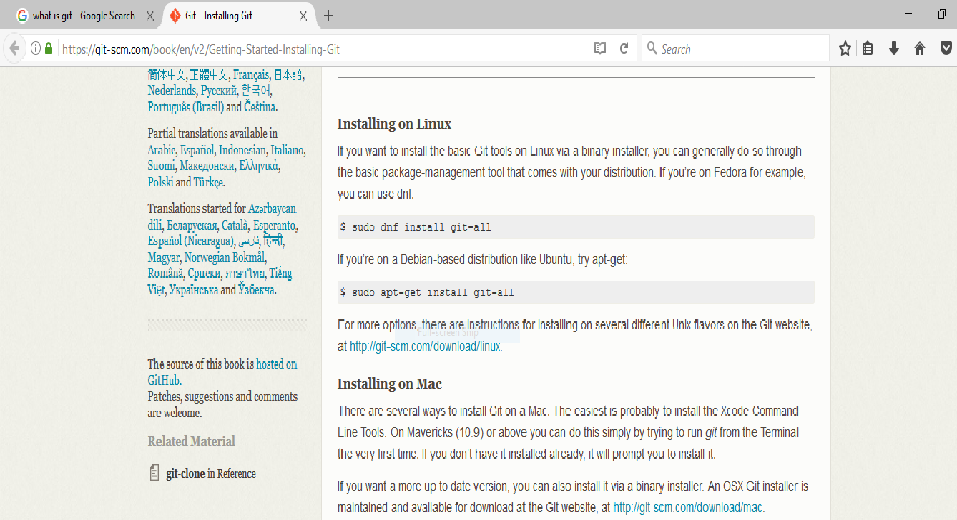
Git installation process
As git a distributed version control system, it can be used as a server out of the box. Dedicated git server software helps, amongst other features, to add access control, display the contents of a git repository via the web, and help managing multiple repositories. Now it depends on you that which machine you gonna install the git software . The installation process is different on linux , windows and Mac . That’s why the below link will help you to understand that what you can do best to install git software on your machine . https://git-scm.com/book/en/v2/Getting-Started-Installing-Git

Slide 3
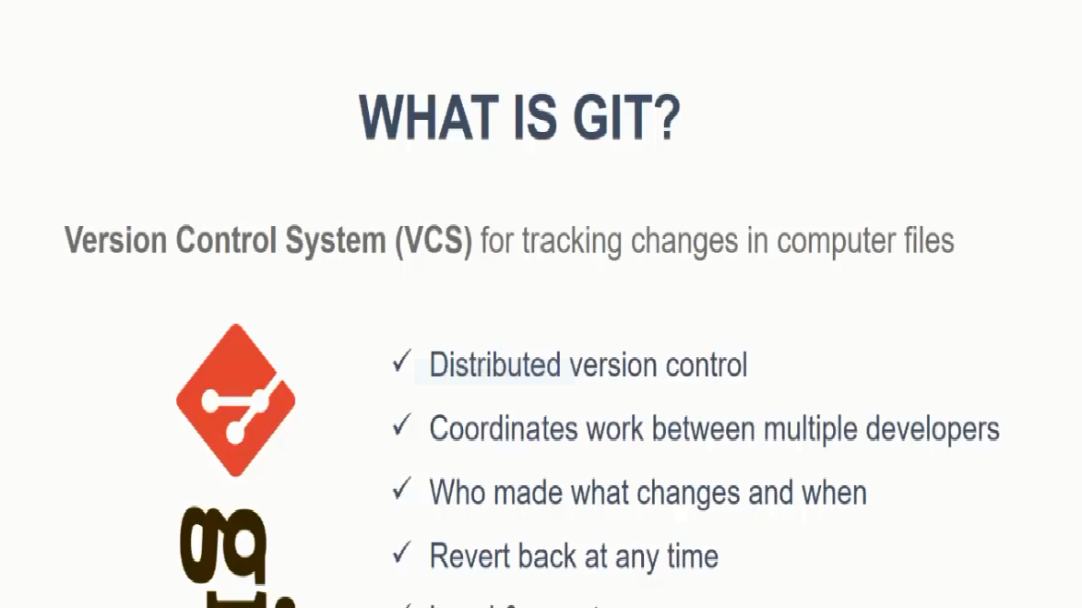
What is Git !

Slide 4
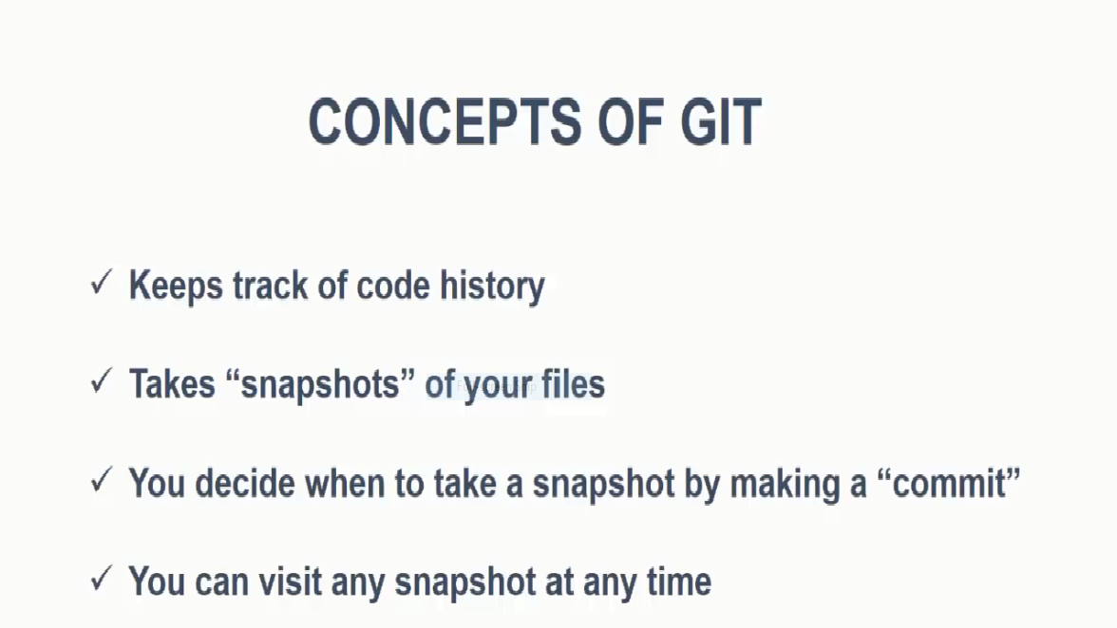
Concepts of git

Slide 5
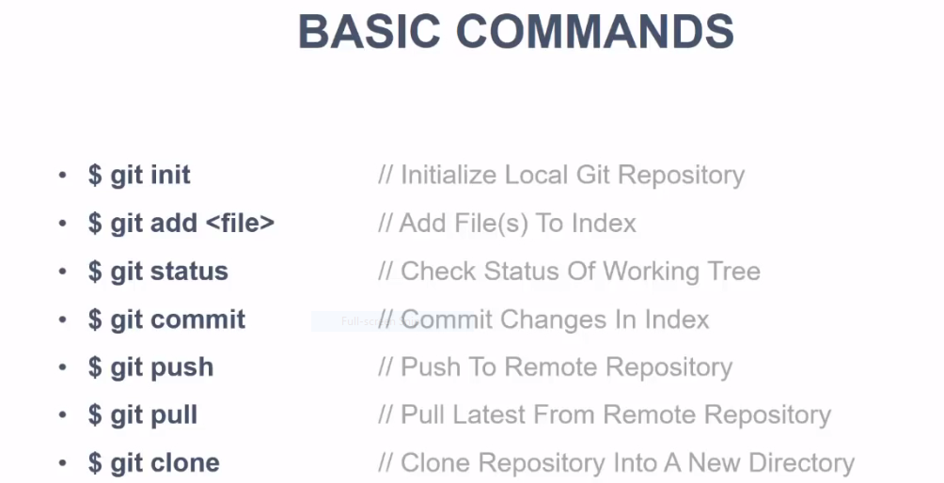
Some basic git command

Slide 6
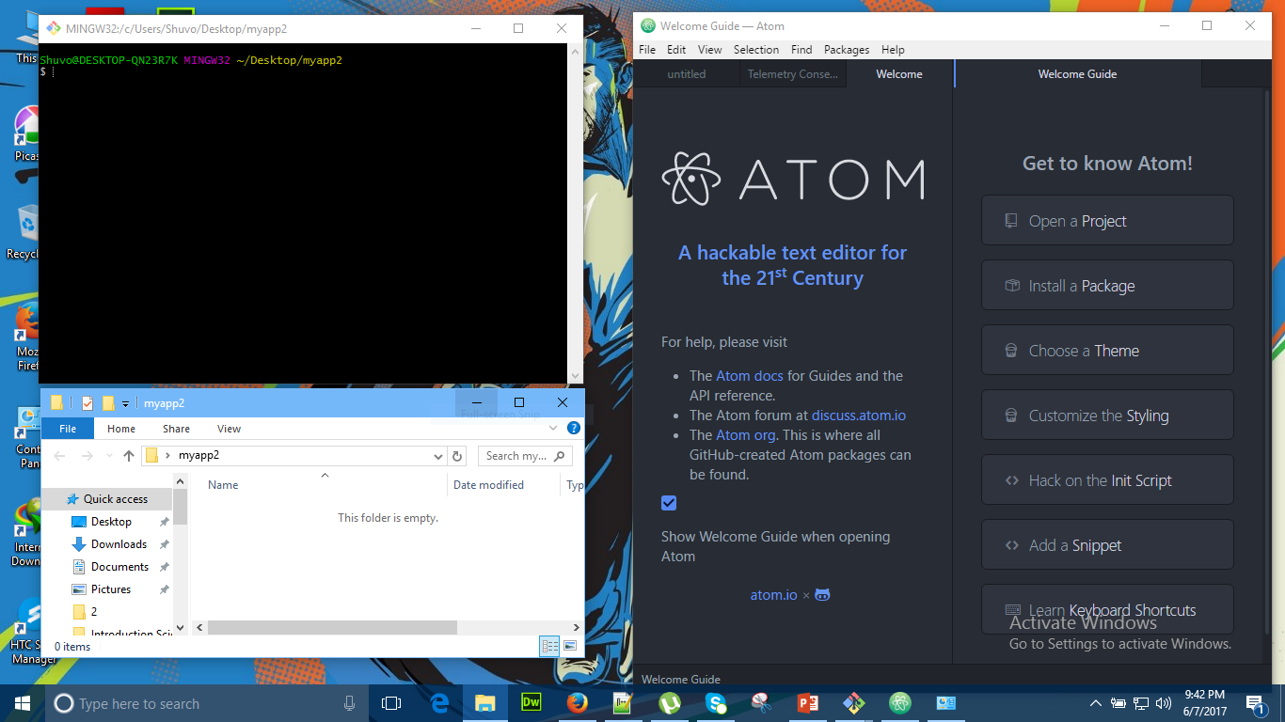
How to start-up and work with git

Slide 7
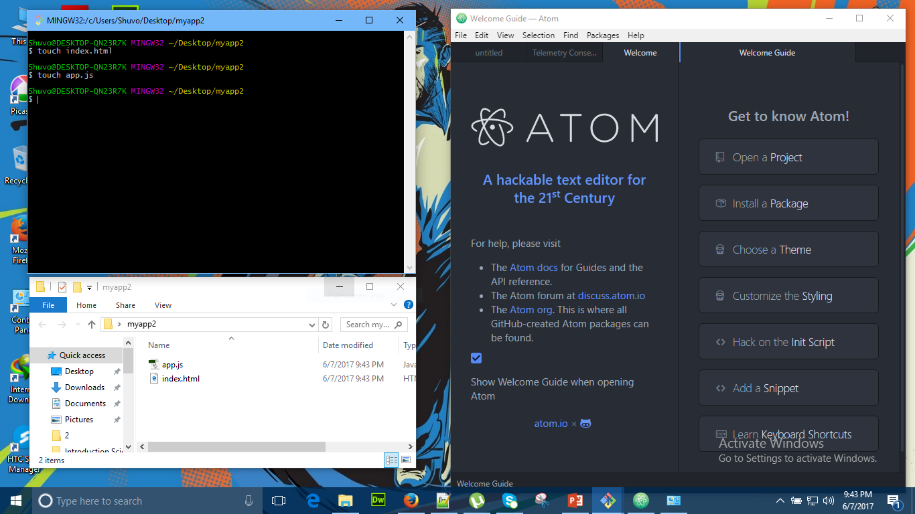
Page 2

Slide 8
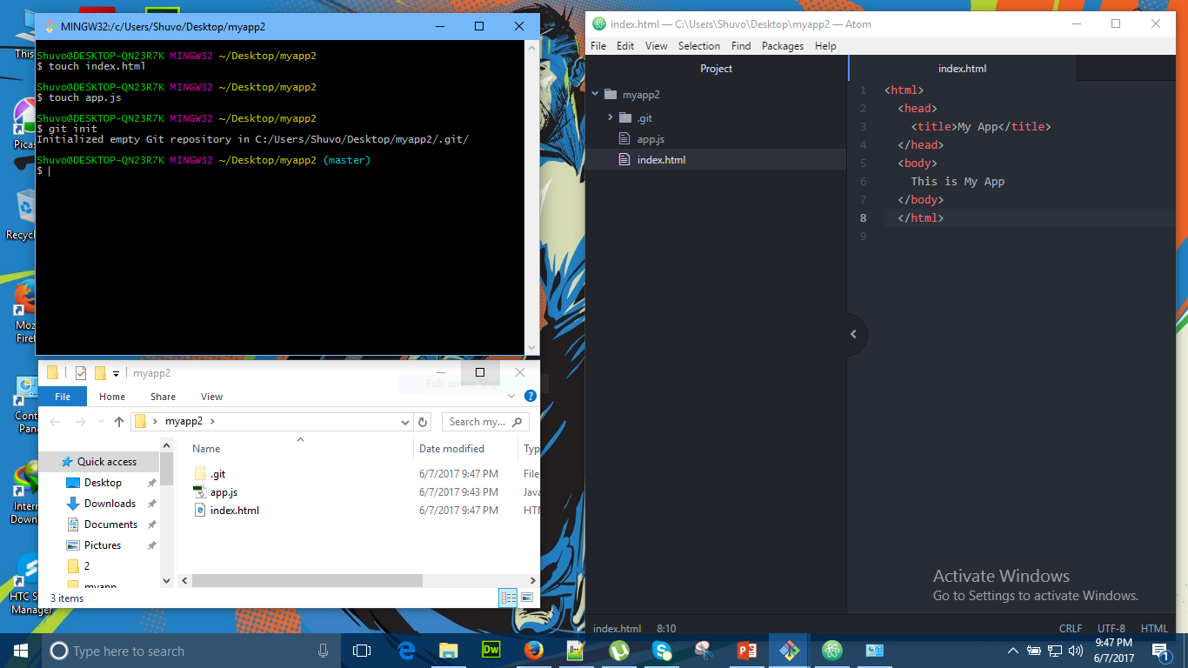
Page -3

Slide 9
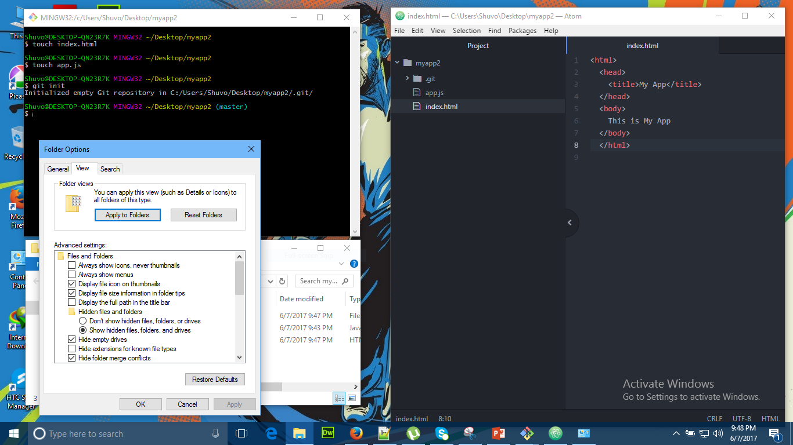
Page 4

Slide 10
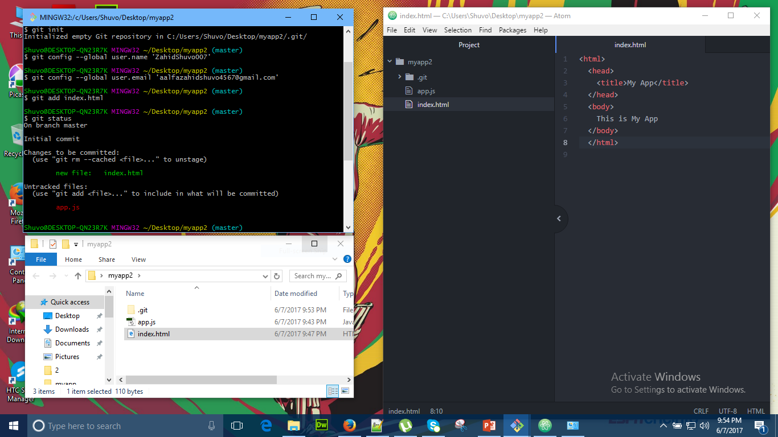
Page 5

Slide 11
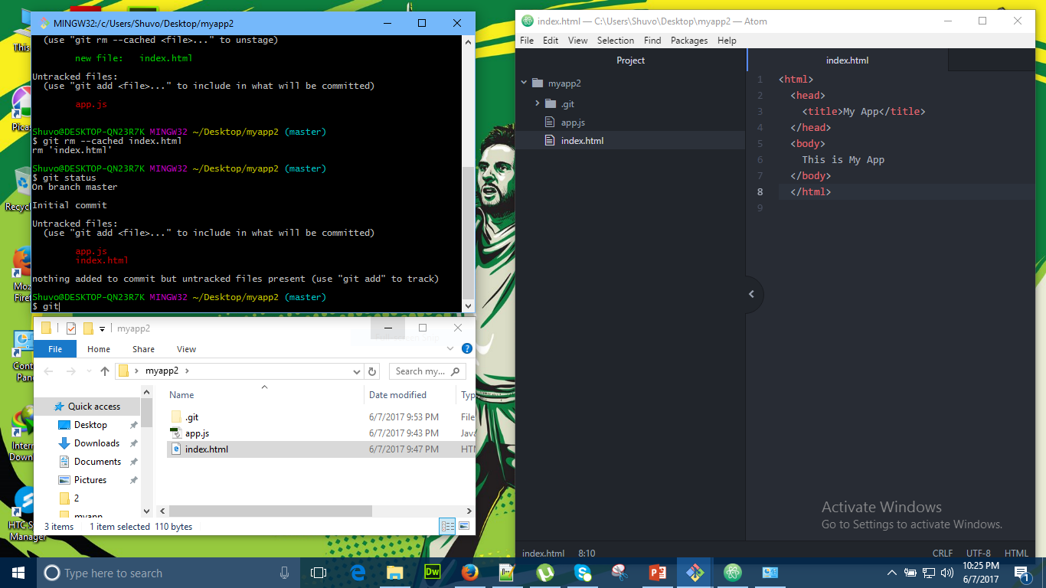
Page 6

Slide 12
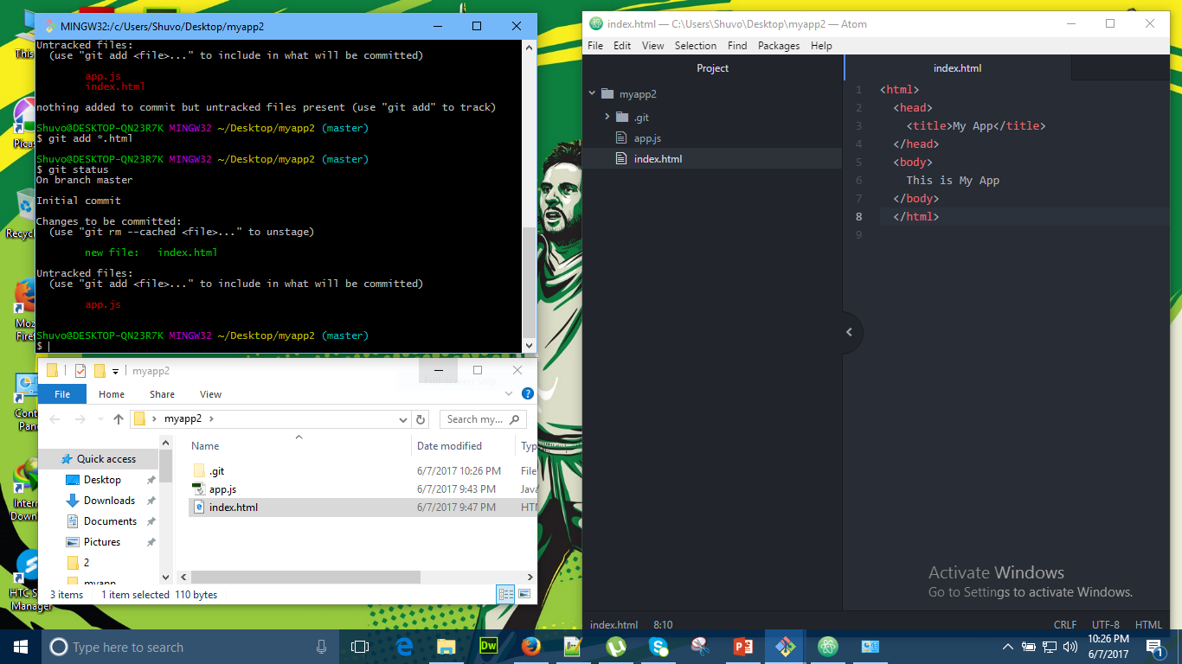
Page 7

Slide 13
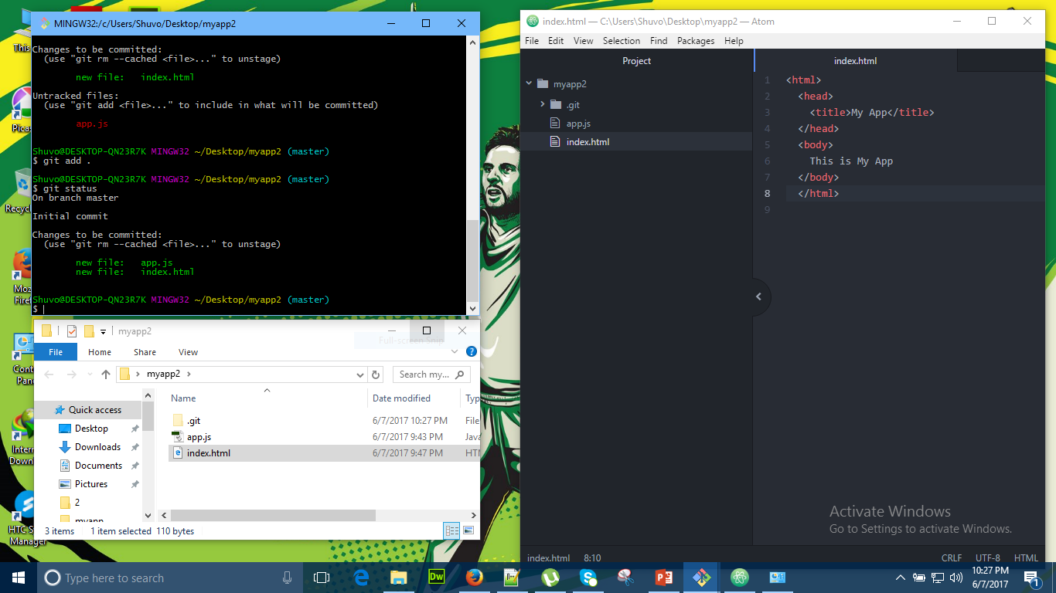
Page 8

Slide 14
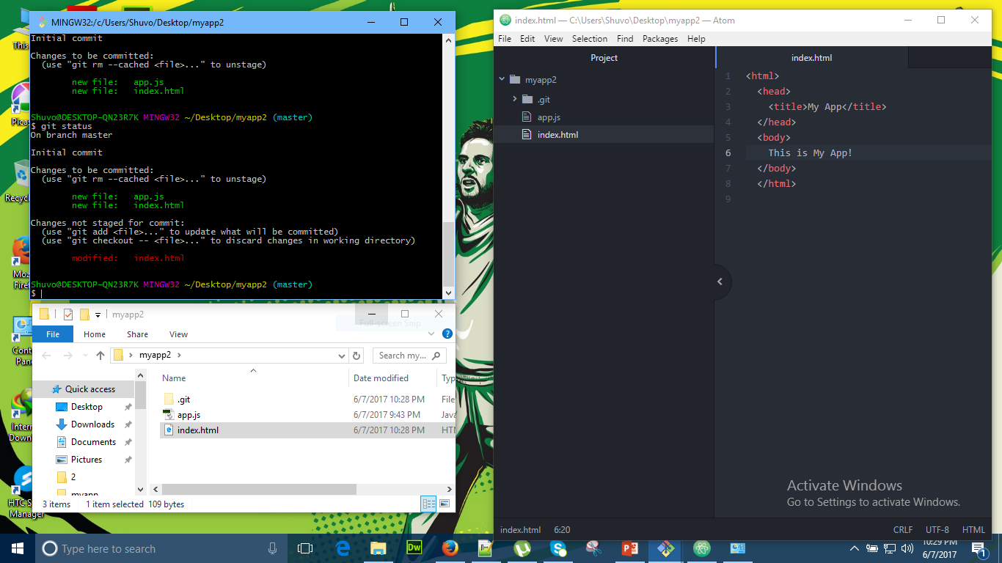
Page 9

Slide 15
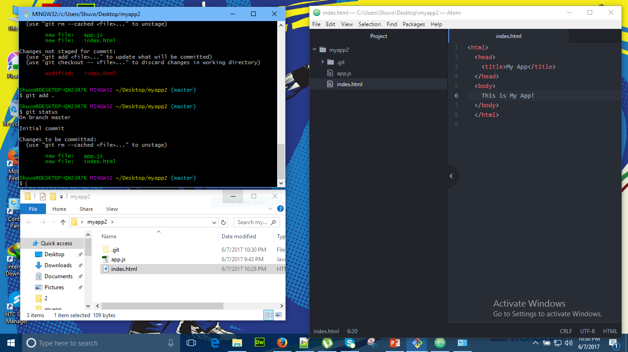
Page 10

Slide 16
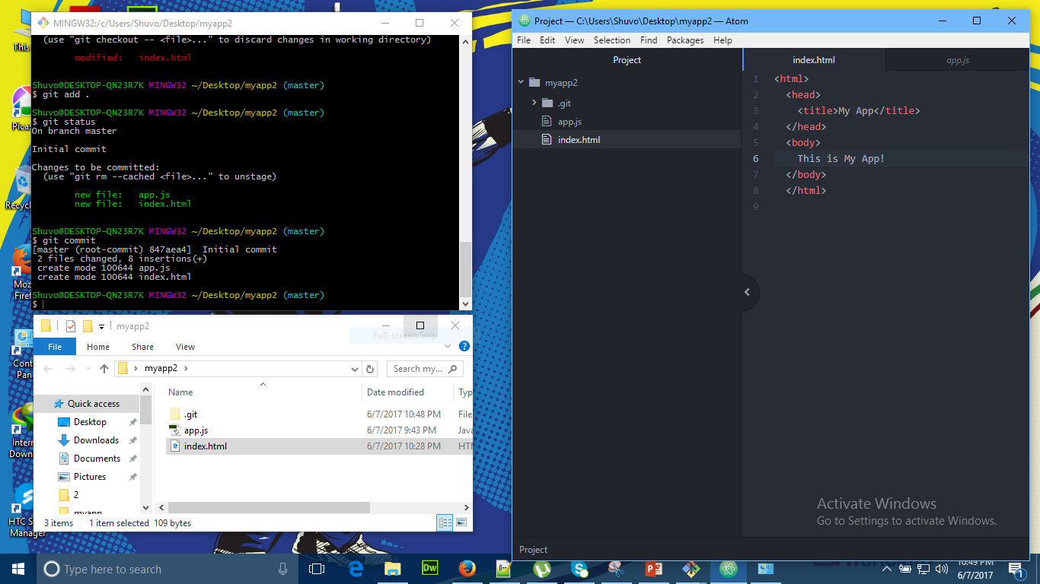
Page 11

Slide 17
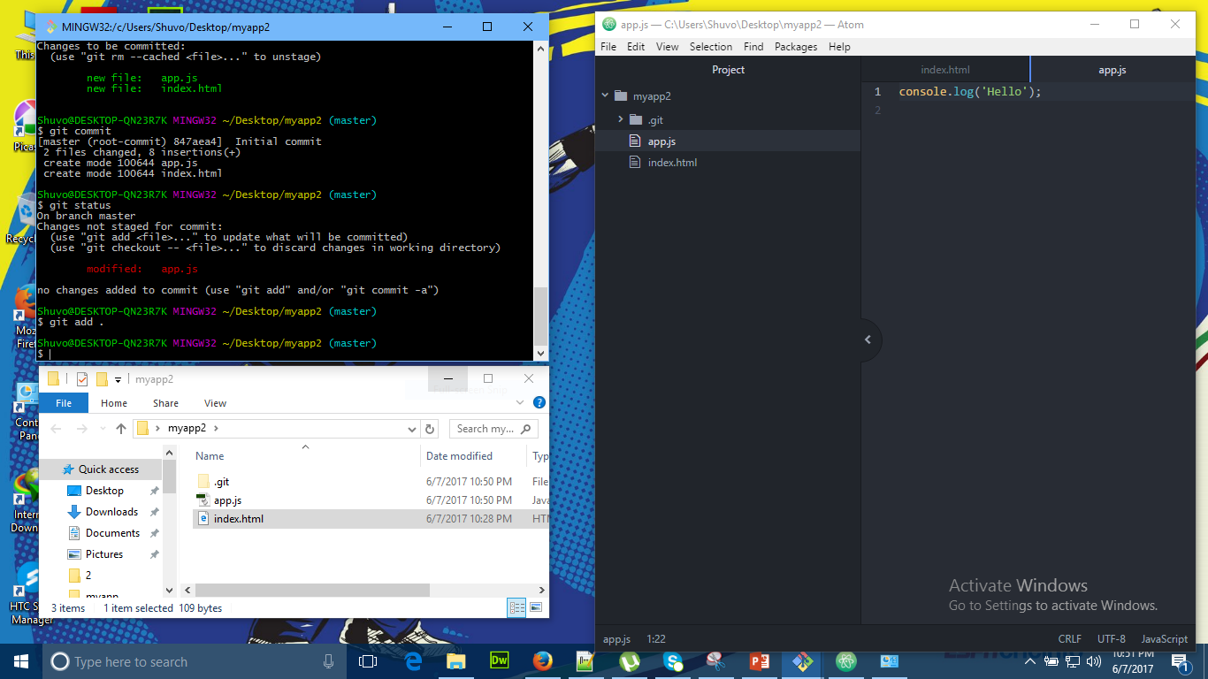
Page 12

Slide 18
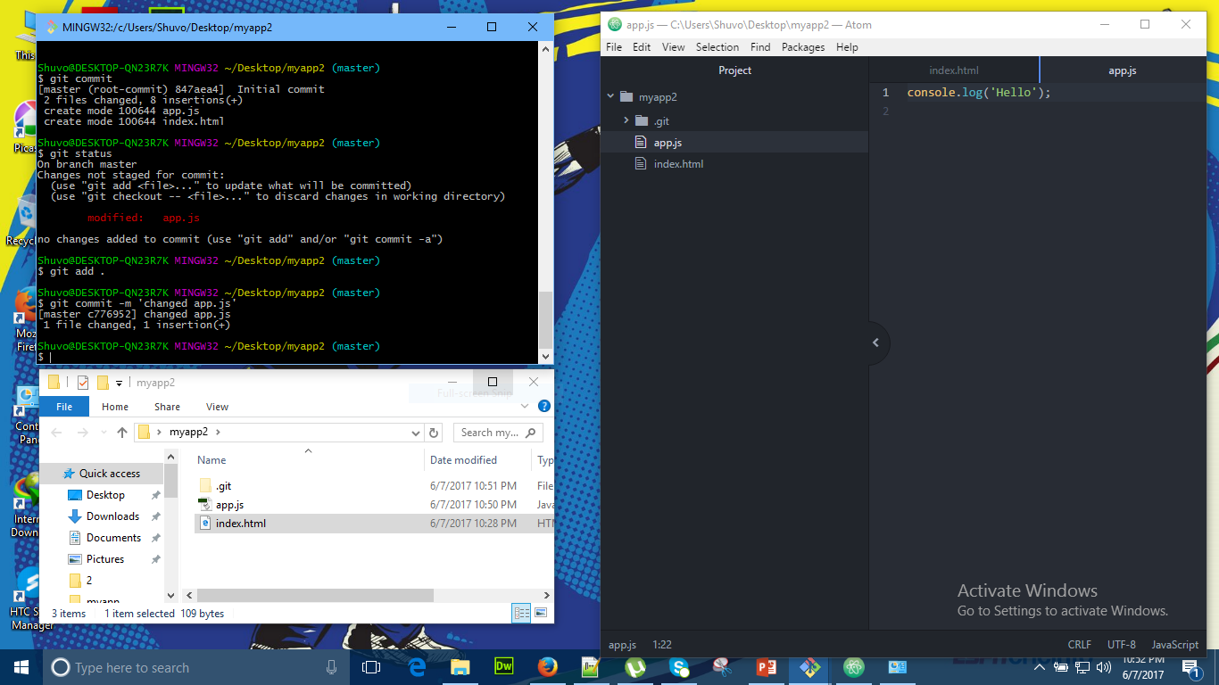
Page 13

Slide 19
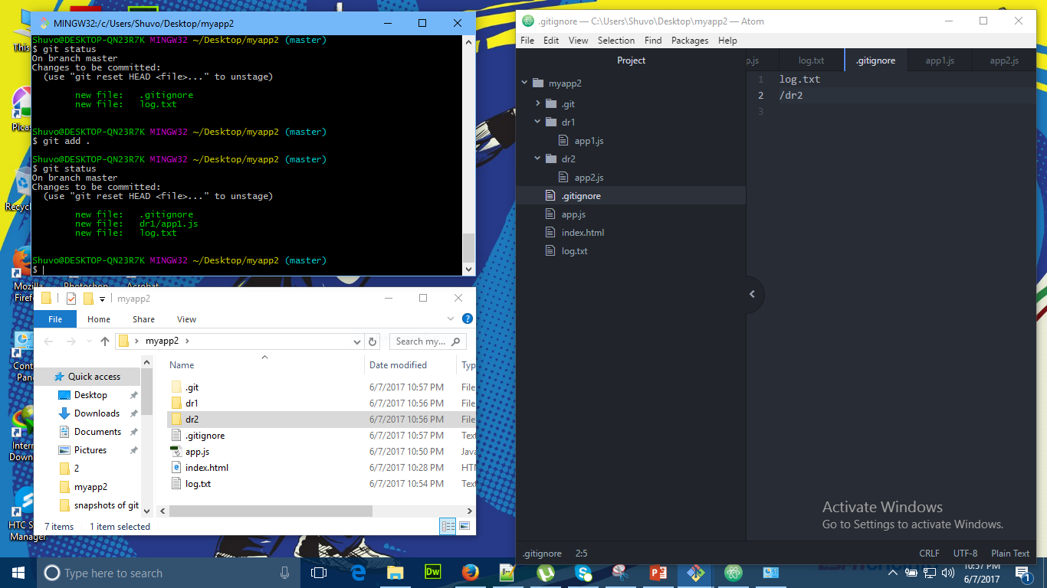
Page 14

Slide 20
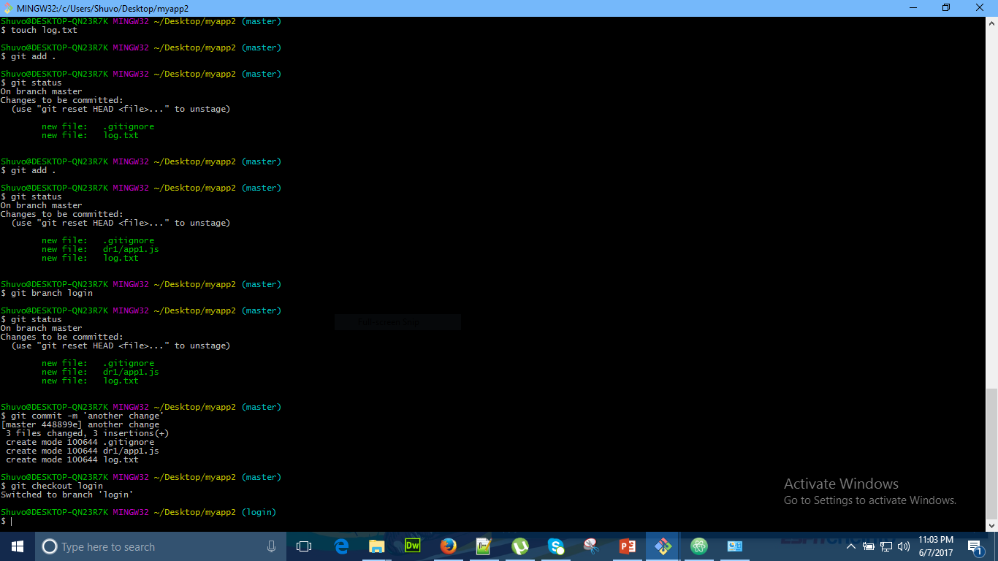
Branch & Merging

Slide 21
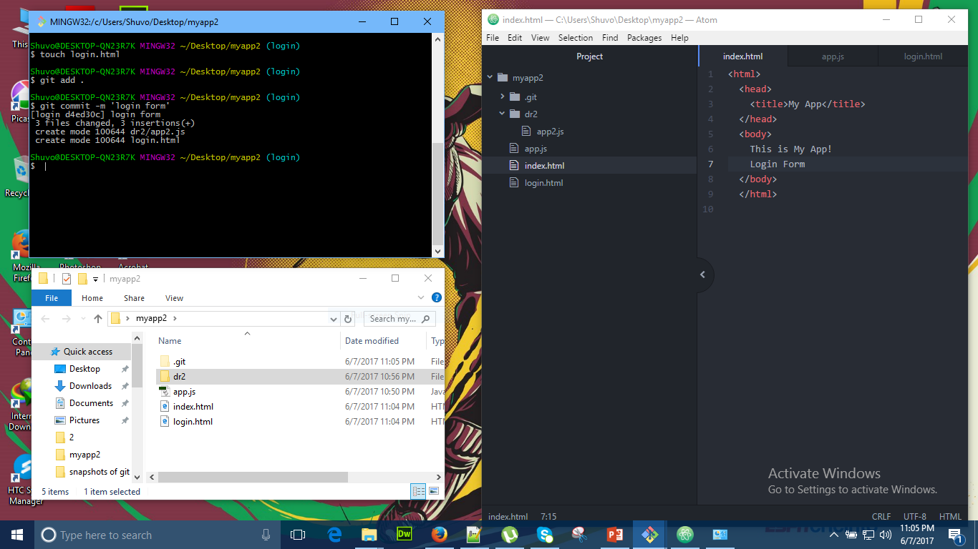
Page 2

Slide 22
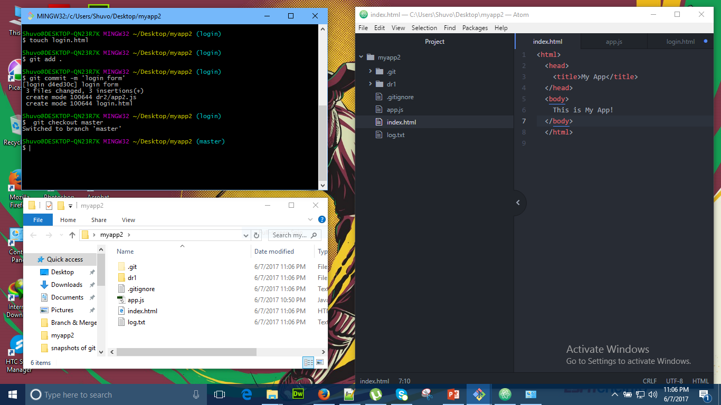
Page 3

Slide 23
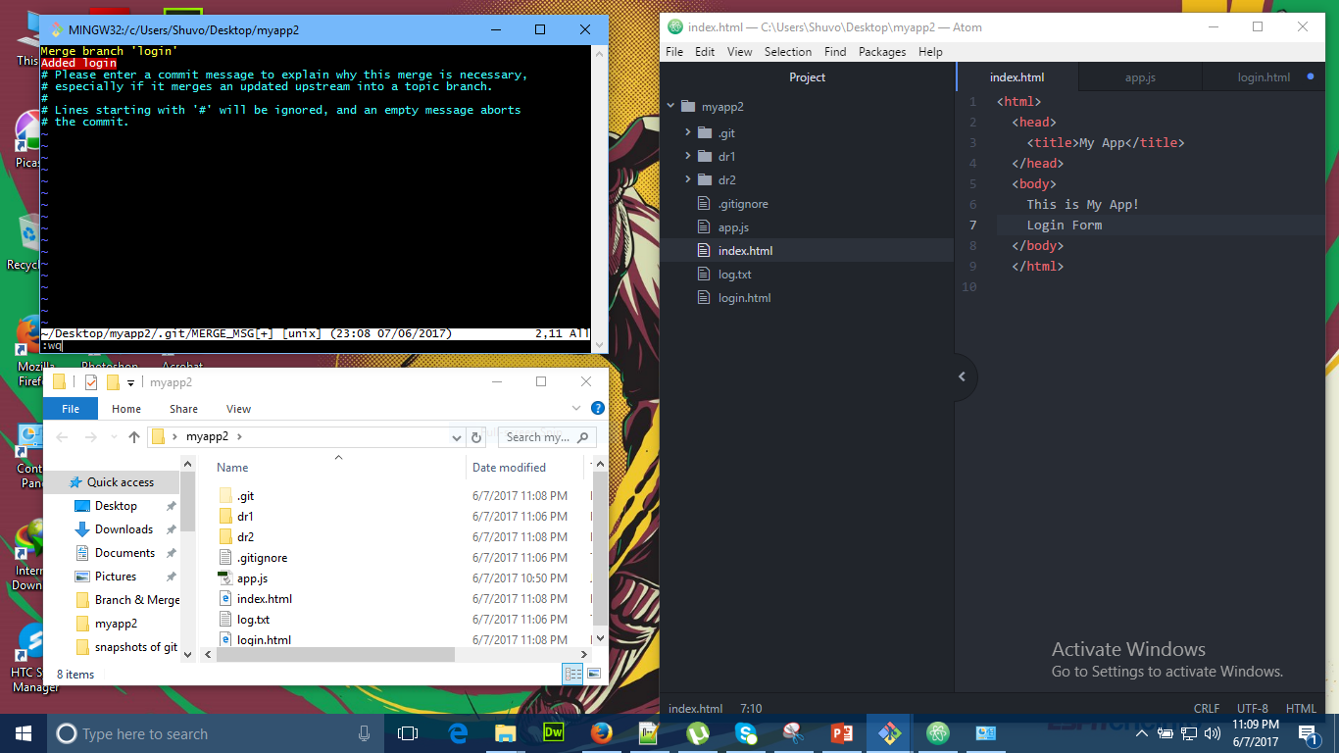
Page 4

Slide 24
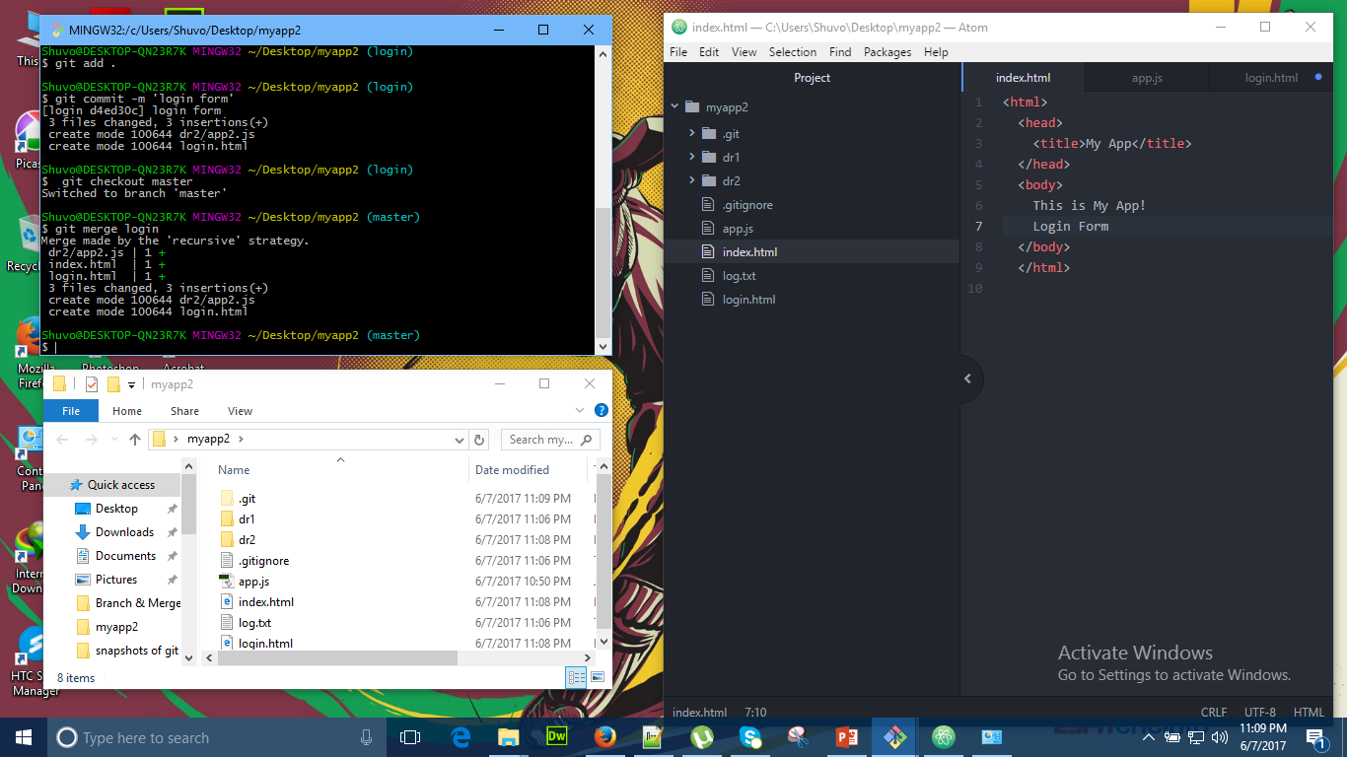
Page 5

Slide 25
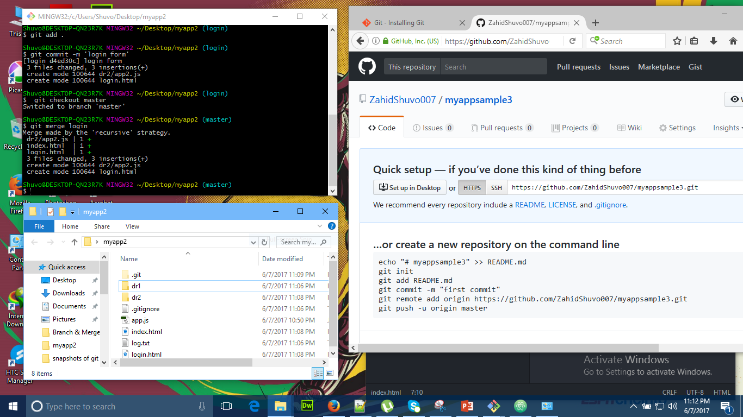
Creating a repository

Slide 26
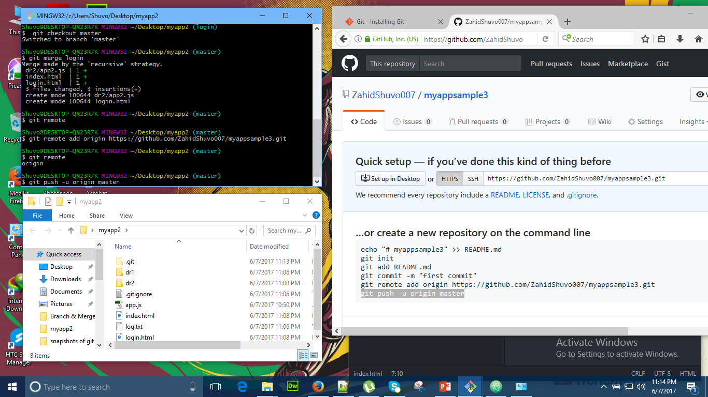
Page 2

Slide 27
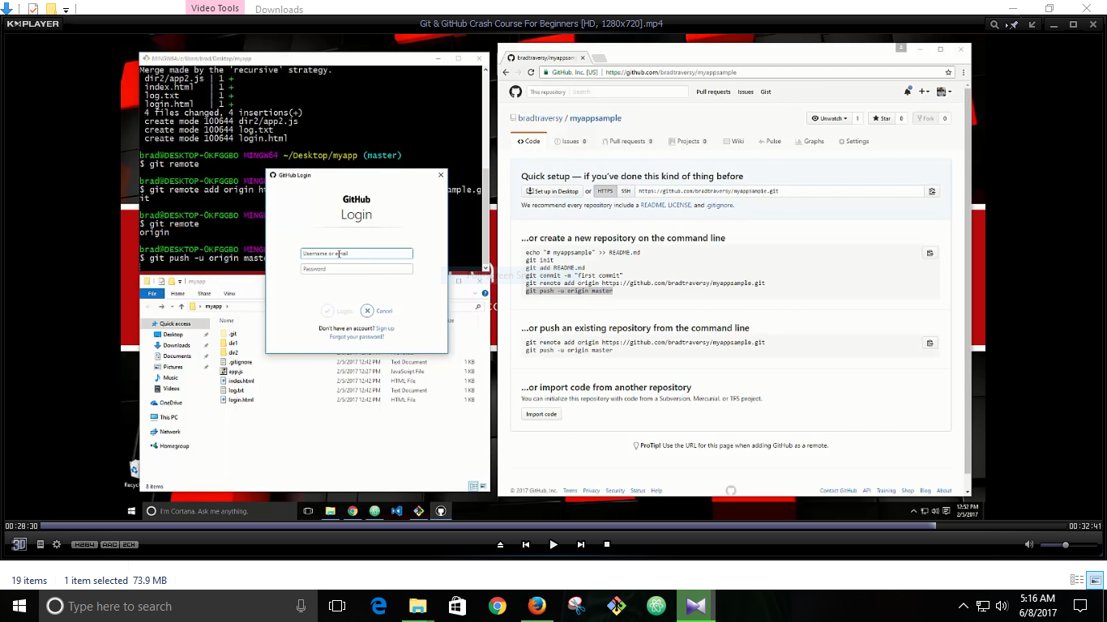
Page 3

Slide 28
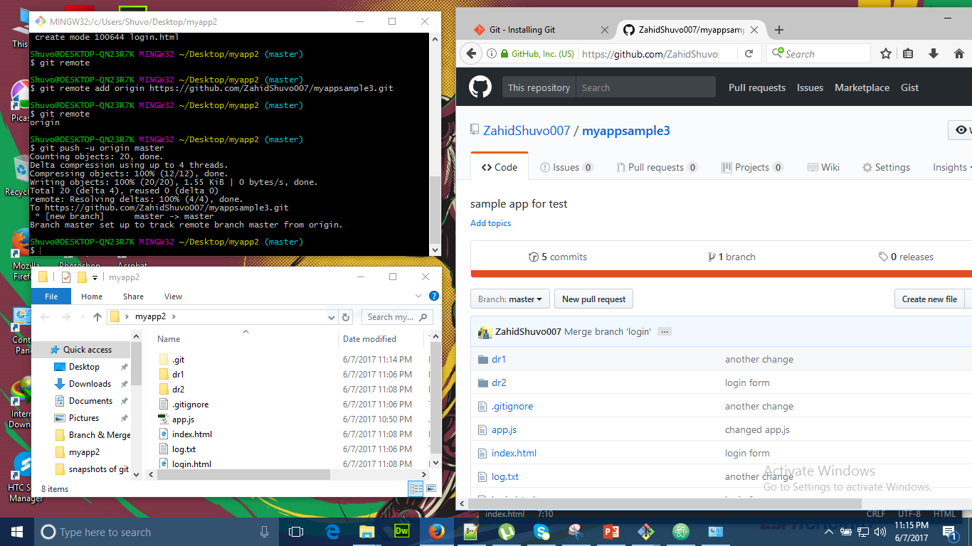
Page 4

Slide 29
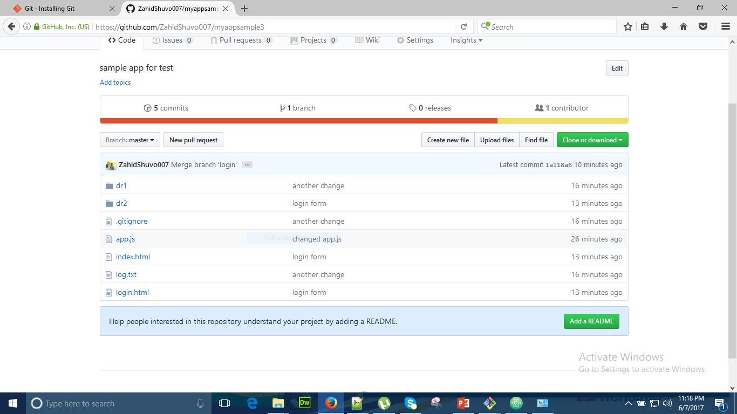
Page 5

Slide 30
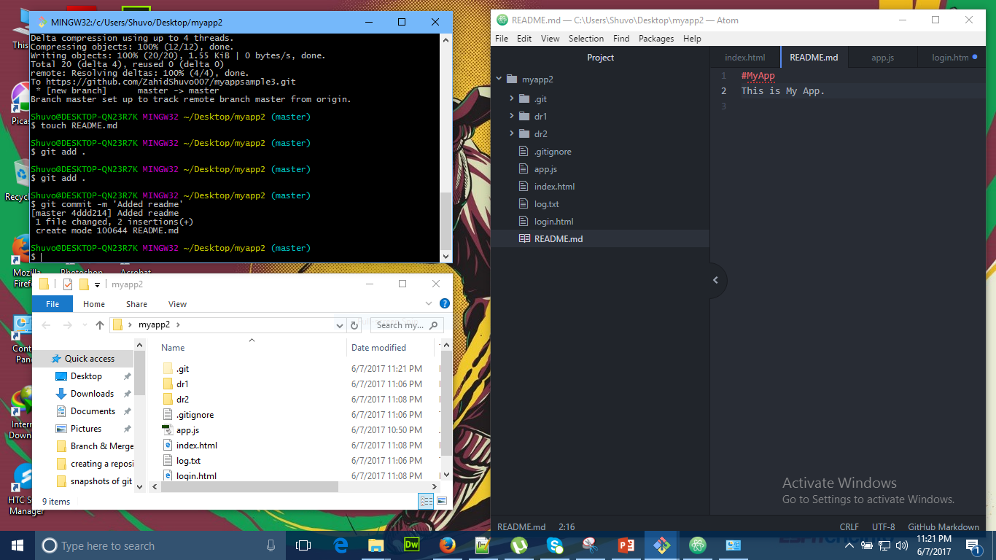
Git push

Slide 31
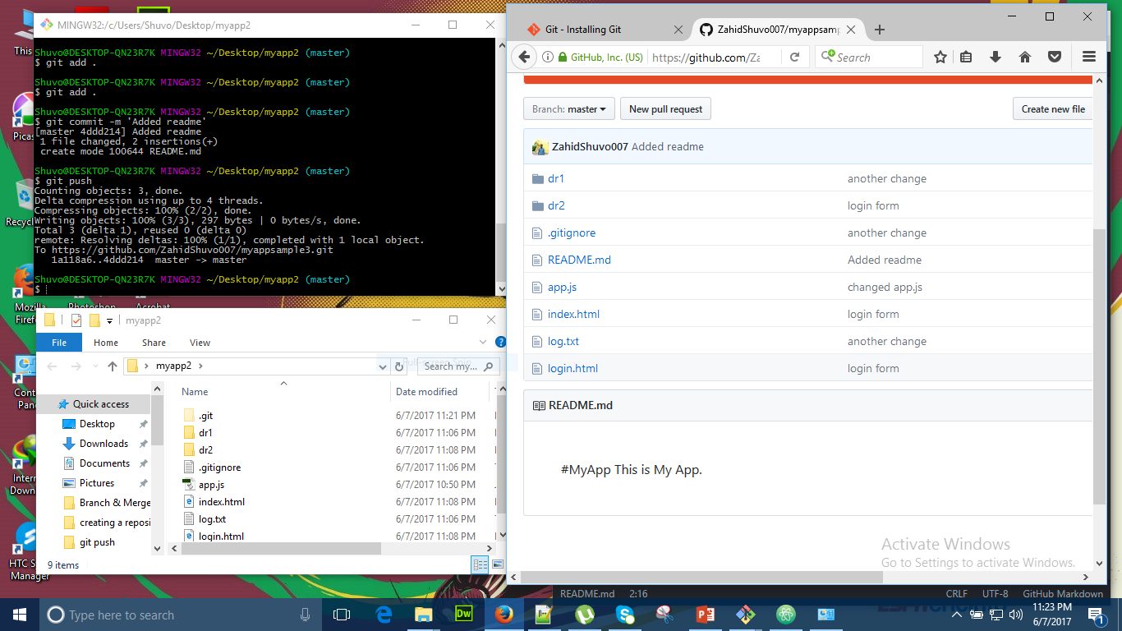
Page 2

Slide 32
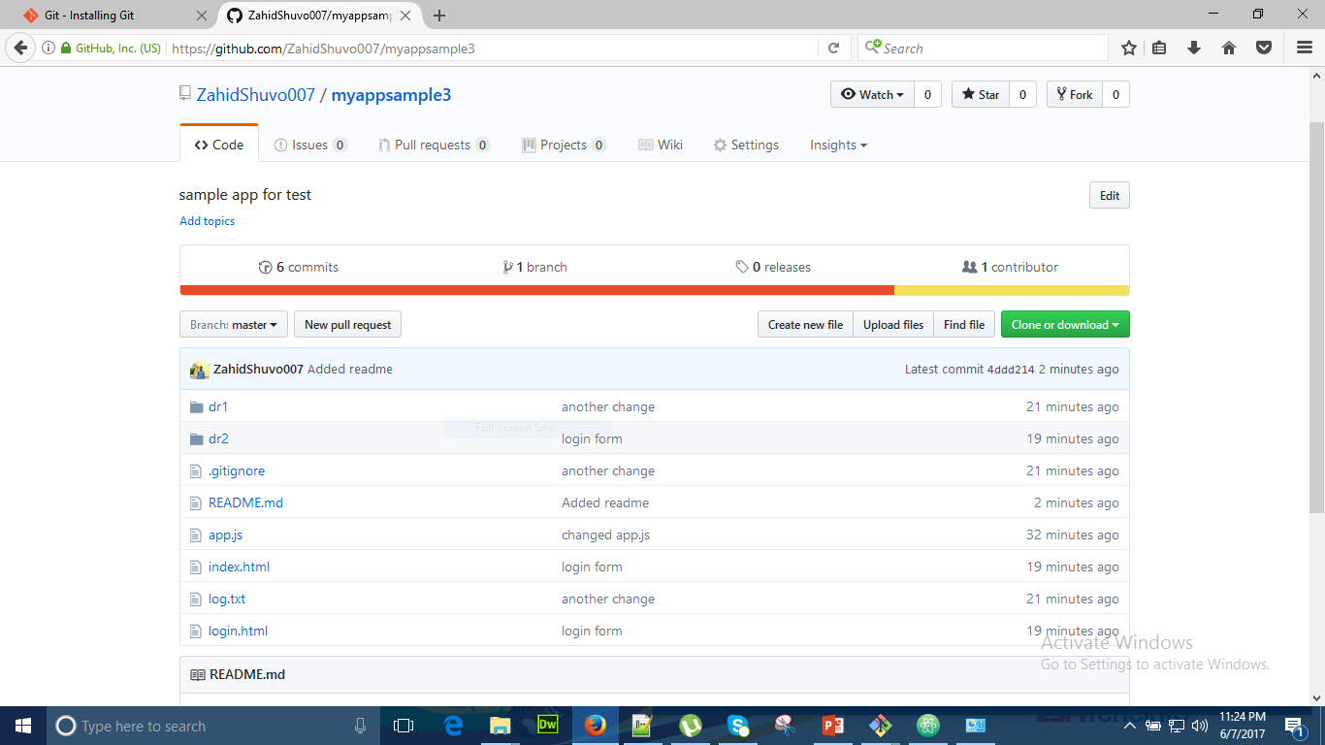
Page 3

Slide 33
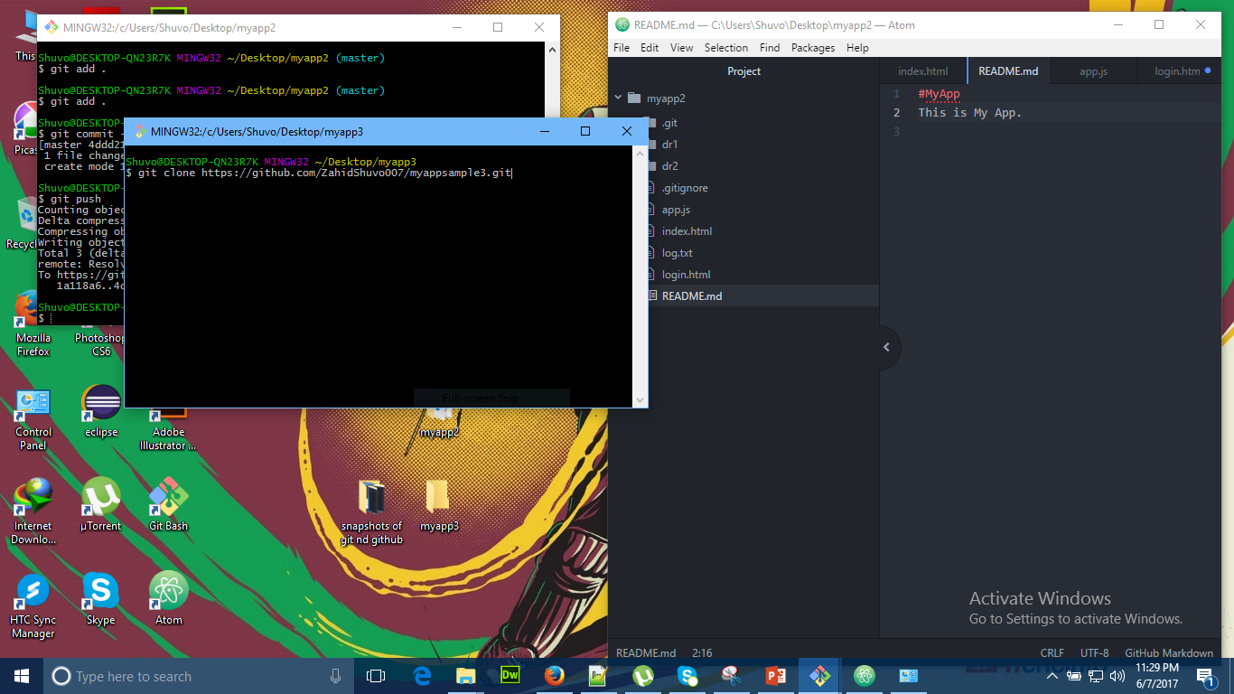
Git clone

Slide 34
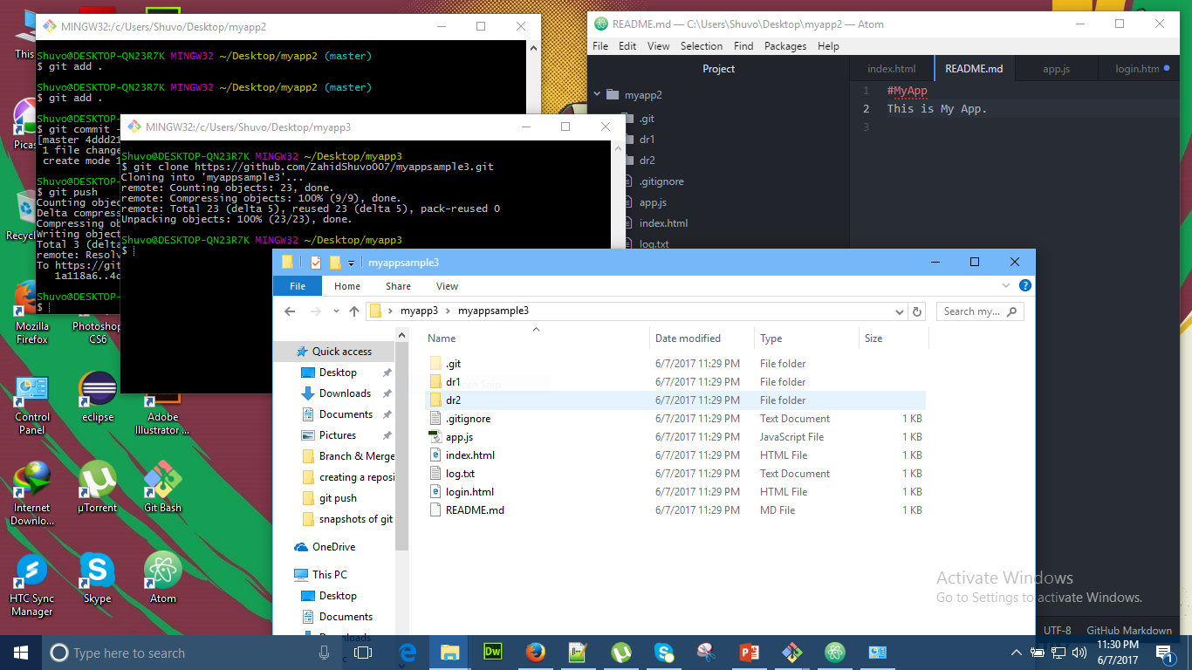
Page 2

Slide 35
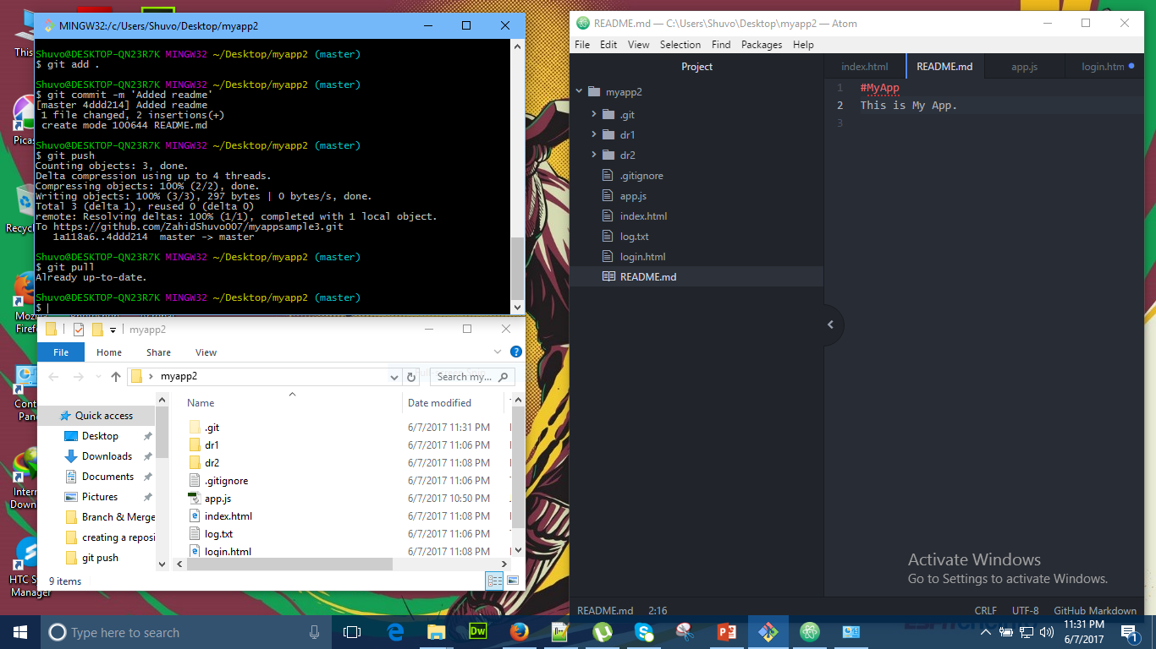
Git pull

